Slide 1
Employee Data Analysis using Excel
STUDENT NAME: G. AKSHAYA
REGISTER NO: 312206567
DEPARTMENT: COMMERCE
COLLEGE: AGURCHAND MANMULL JAIN COLLEGE.

Slide 2
PROJECT TITLE
Employee
Performance
Analysis using
Excel

Slide 3


AGENDA
Problem Statement
Project Overview
End Users
Our Solution and Proposition
Dataset Description
Modelling Approach
Results and Discussion
Conclusion
3/21/2024 Annual Review

Slide 4

Problem Statement :
It helps to inform decisions
About promotions, compensation ,and other HR related matters.
Through regular and proper performance evaluations the company can improve employee productivity.

Slide 5

PROJECT OVERVIEW
Employee performance Analysis is done to help identify areas for improvement, evaluate accomplishment, and provide feedback.

Slide 6

WHO ARE THE END USERS? Employees Managers Employers Managerial organisations Industrial organisations

Slide 7

OUR SOLUTION AND ITS VALUE PROPOSITION Conditional formatting - missing Pivot tables - summary Charts – trend Filtering and Formula - performance Graph – data visualization

Slide 8
DATASET DESCRIPTION: Employee = Kaggle 26 – Features 9 - Features Employee id – numerical values Name – text Employee type Performance level Employee rating – numerical values

Slide 9

THE "WOW" IN OUR SOLUTION
Performance level =SVG(Z8>=5,”VERY HIGH”,Z8>=4,”HIGH”,Z8>=3,”NVL”,TRUE,”LOW”)
3/21/2024 Annual Review
9

Slide 10
MODELLING:
Data collection
Downloaded from Edunet dashboard
Data cleaning
Identified the missing values
Filter out missing values
Performance level
Created a formula
Summary
Pivot table
Graph
10

Slide 11
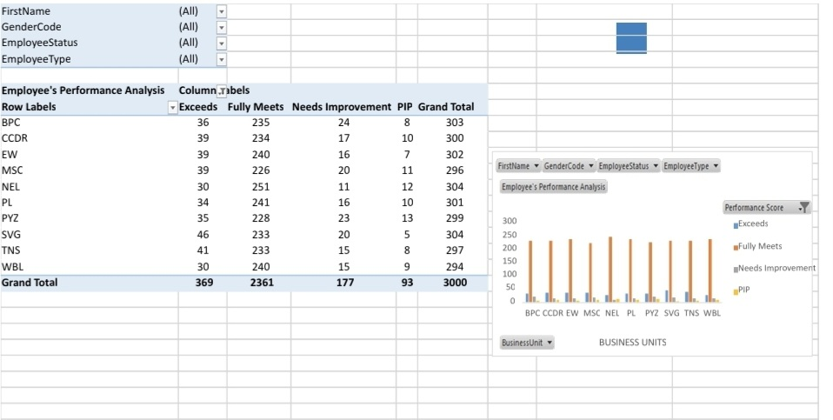
Results
11

Slide 12
Conclusion :
As per the charts and data of performance of the employees almost all of them have fully meet their as well as some of the exceeds the needs such as SVG .
Therefore such performance shall be encouraged and brief definition of company’s goal and objectives.

